Slide 1

Daniel Neill
Executive Director
Midwest HIDTA

Slide 2
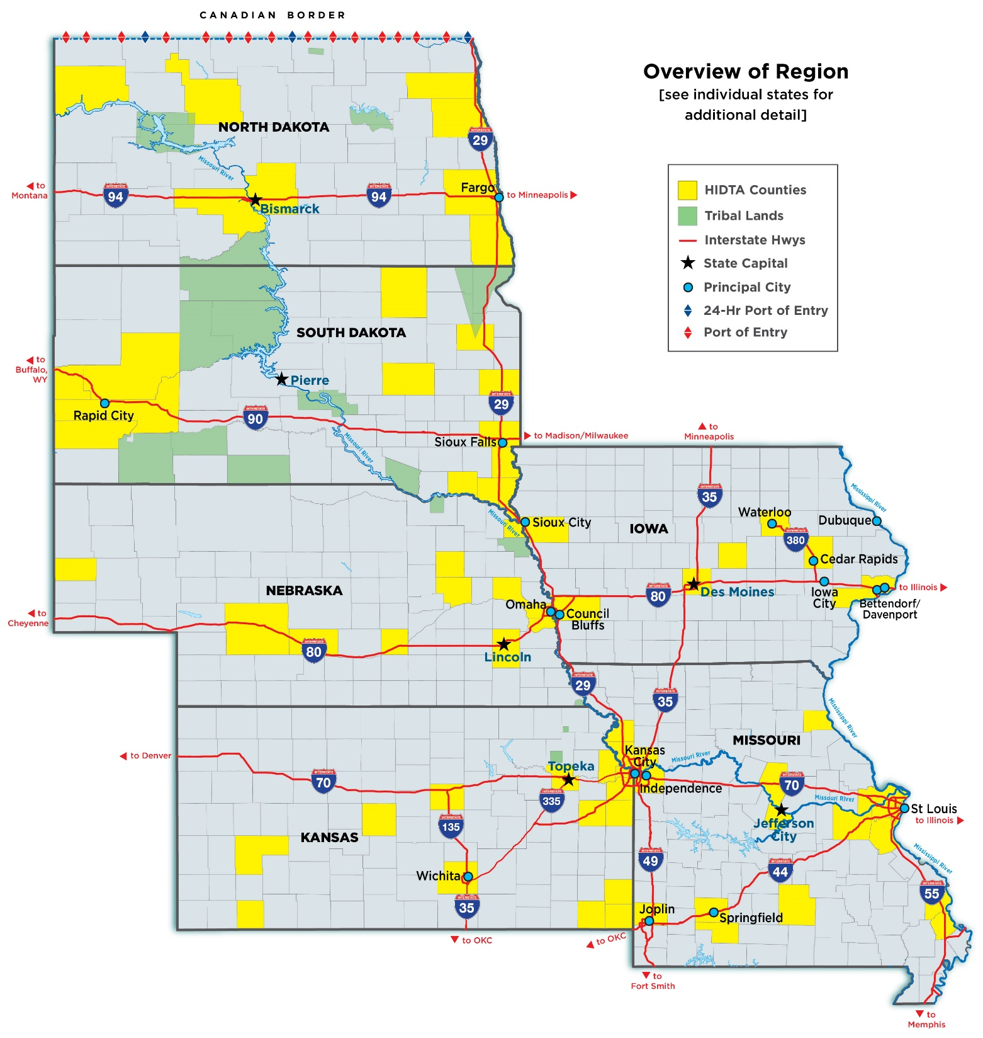

Slide 3
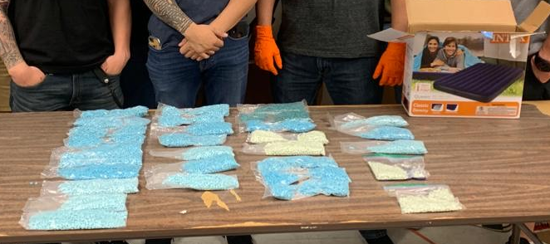
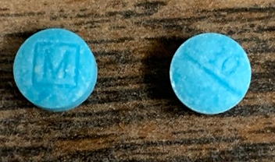
Most Recent Fentanyl Seizure
Notes:
Most recently on October 29,2019, DEA along with the Task Force Officers recently seized 3531.7 grams of round circular pills (possibly Fentanyl. The pills were of various shades of blue and green and packaged in 30 individual clear plastic bags.
This will be sent to the DEA Southwest Laboratory for further analysis.

Slide 4
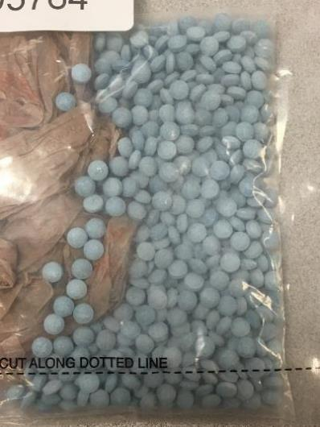
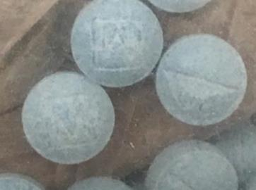
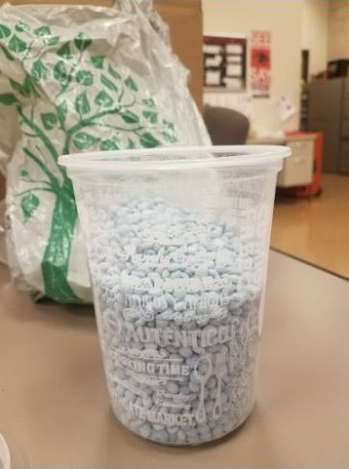
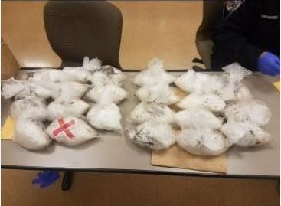
Counterfeit Oxycodone laced w/ Fentanyl and Meth
Notes:
These pills came from Tijuana, Mexico, the main ingredient is Fentanyl. This is done to increase it’s potency.
The contact was made through a Buy Program then later a bust was made.
Initially, TDS conducted a controlled purchases totaling approximately 1000 Oxy tablets
Later, a search warrant was executed. As a result of the search, the LVDO/TDS seized approximately 10,000 Oxy Tablets and 20+ Kilo’s of meth.
Research shows this counterfeit pill (The M on one side of the pill and 30 on the other side) has been seen throughout the southwest as far back as 2016.

Slide 5
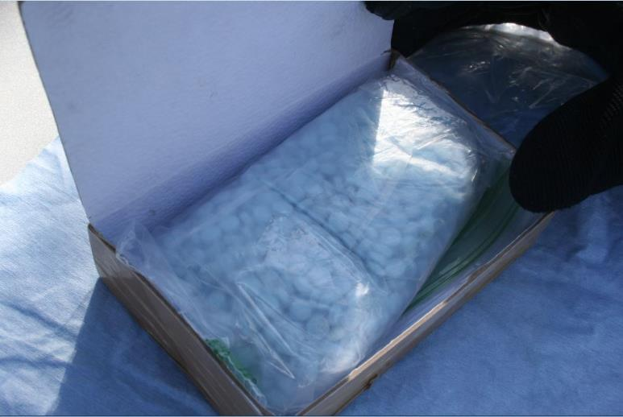
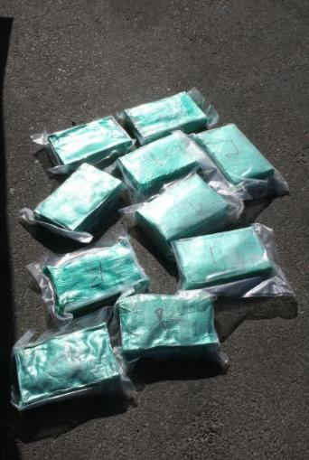
Counterfeit Oxycodone and Heroin laced w/ Fentanyl
Notes:
1,000 pills from SINALOA, Mexico obtained through a bust. This bust turned up 22 pounds heroin along with the pills.
Lab reports indicate the heroin and counterfeit pills are laced with Fentanyl. This is done to increase it’s potency.

Slide 6
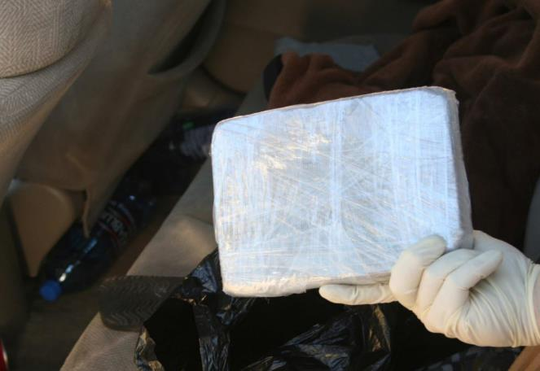
Fentanyl/Heroin Brick
Notes:
This Fentanyl/Heroin brick is the most dangerous due to it being in powder form.
Search and Seizure of traffic stop by TDS.

Slide 7

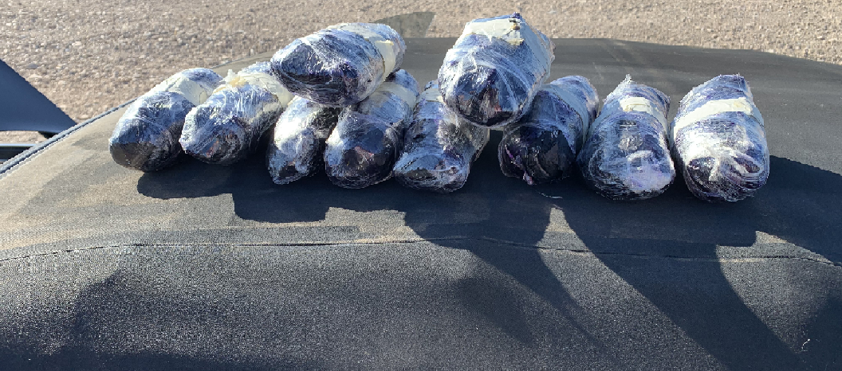
Hidden compartment seizure of Methamphetamine
Notes:
This seizure occurred on November 5, 2019 DEA/LVDO, FBI and Southern Nevada Interdiction Task Force, they came across during a vehicle search 10 pounds methamphetamine a street value of about $20,000. This is an on-going investigation.

Slide 8
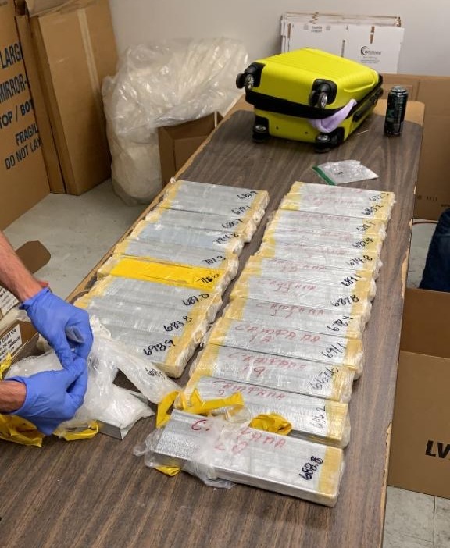
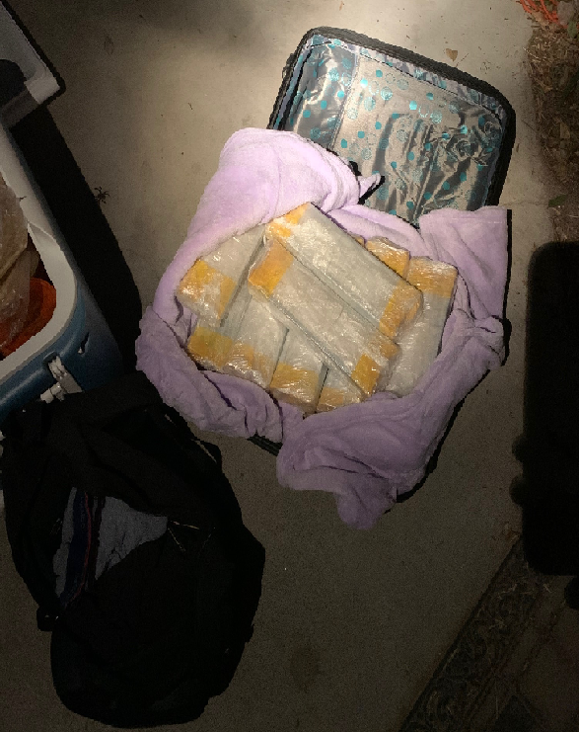
Seizure of Methamphetamine, Heroin and US Currency
Notes:
Most recently on November 9, 2019 DEA/LVDO and Clark County Gang Task Force, came across during a vehicle search 15kgs of methamphetamine, 1kg of heroin and $3,000 in US Currency, This is an on-going investigation.

Slide 9

Club Drugs

Slide 10

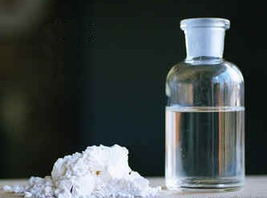
Popular Club Drugs
Ecstasy or MDMA
GHB
Notes:
MDMA:
A synthetic drug that alters mood and perception
People who use MDMA usually take it as a capsule or tablet, though some swallow it in liquid form or snort the powder.
GHB - Gamma Hydroxybutyrate:
- A central nervous system depressant that is commonly referred to as a “club drug” or “date rape” drug.
- GHB is available as an odorless, colorless drug that may be combined with alcohol and given to unsuspecting victims prior to sexual assaults.
- A depressant approved for use in the treatment of narcolepsy, a disorder that causes daytime "sleep attacks."

Slide 11
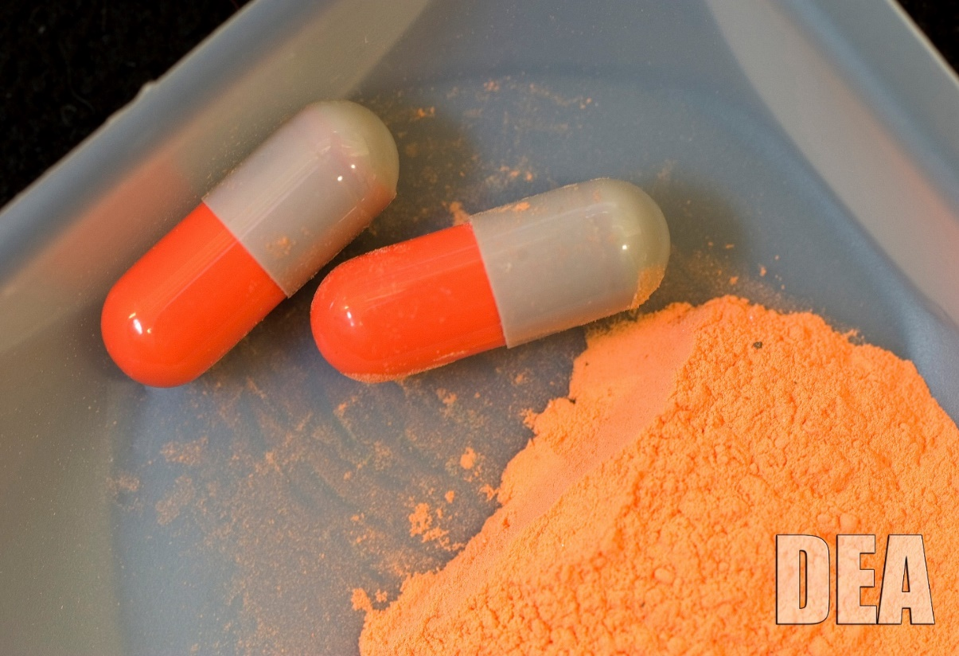
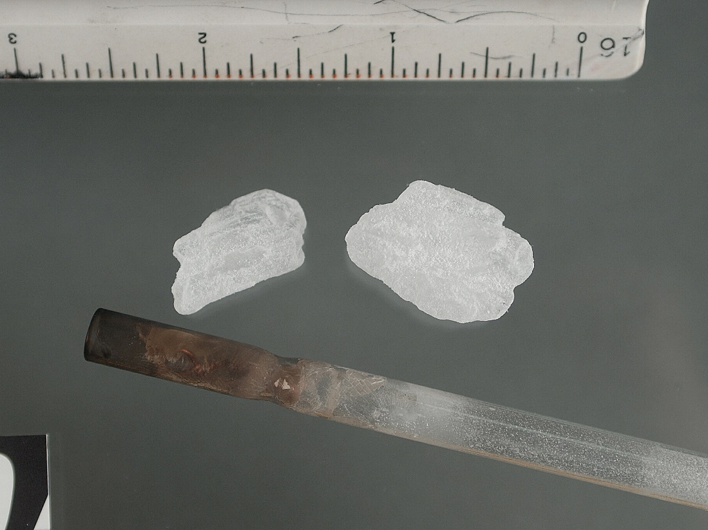
Popular Club Drugs
LSD
Ice or Meth
Notes:
LSD:
- a potent hallucinogen that dramatically alters your thoughts and your perception of reality.
- LSD is sold in tablets, capsules or in liquid form. It is commonly added to absorbent paper and divided into small decorated squares. Each square is a dose.
Ice or Meth:
- An extremely addictive stimulant drug that is chemically similar to amphetamine.
- It takes the form of a white, odorless, bitter-tasting crystalline powder.

Slide 12
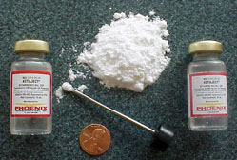

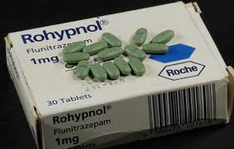
Other Club Drugs
Ketamine
K2/Spice
Rohypnol
Notes:
Ketamine:
- Ketamine is an animal tranquilizer that can knock you out, and leave you unconscious and vulnerable.
- Produces a range of effects, from intoxication to delirium. It can also make you unable to move and feel pain.
Spice:
Synthetic marijuana – or spice – can result in brain alterations similar to the real thing, but with the added danger that many of its chemical components and other ingredients are often unknown.
Spice is a mildly hallucinogenic mix of dried plant material that is laced with synthetic cannabinoids
Rohypnol:
Dangerous when taken on its own, and fatally dangerous when combined with alcohol, Rohypnol is horrifyingly infamous for being the “date-rape drug.”
Rohypnol is a central nervous system depressant medication that is not approved or available for medical use in the United States.

Slide 13

Prescription Opioids
The National Problem

Slide 14
Popular Prescription Drugs of Abuse
Oxycodone
  OxyContin®
  Percocet/Percodan
Oxymorphone
  Opana
Amphetamine Mix
  Adderall®
Fentanyl
Hydrocodone
  Vicodin
  Norco
  Lortab
Alprazolam
  Xanax
Suboxone
Valium
Notes:
Self-Explanatory.
The street names for some of the drugs are:
Oxycodone – Oxy, Cotton, Os, Oxy’s, OC
Adderall – Beans, Double trouble
Hydrocodone – Hydro
Vicodin – Vikes, Vico, Vic
Xanax – Z-bar, Bricks, Benzos

Slide 15

Targeting the Supply and Demand Problem
Notes:
- The US makes up 5% of the world population but consumes 99% of the worlds hydrocodone. Do you see a problem?

Slide 16
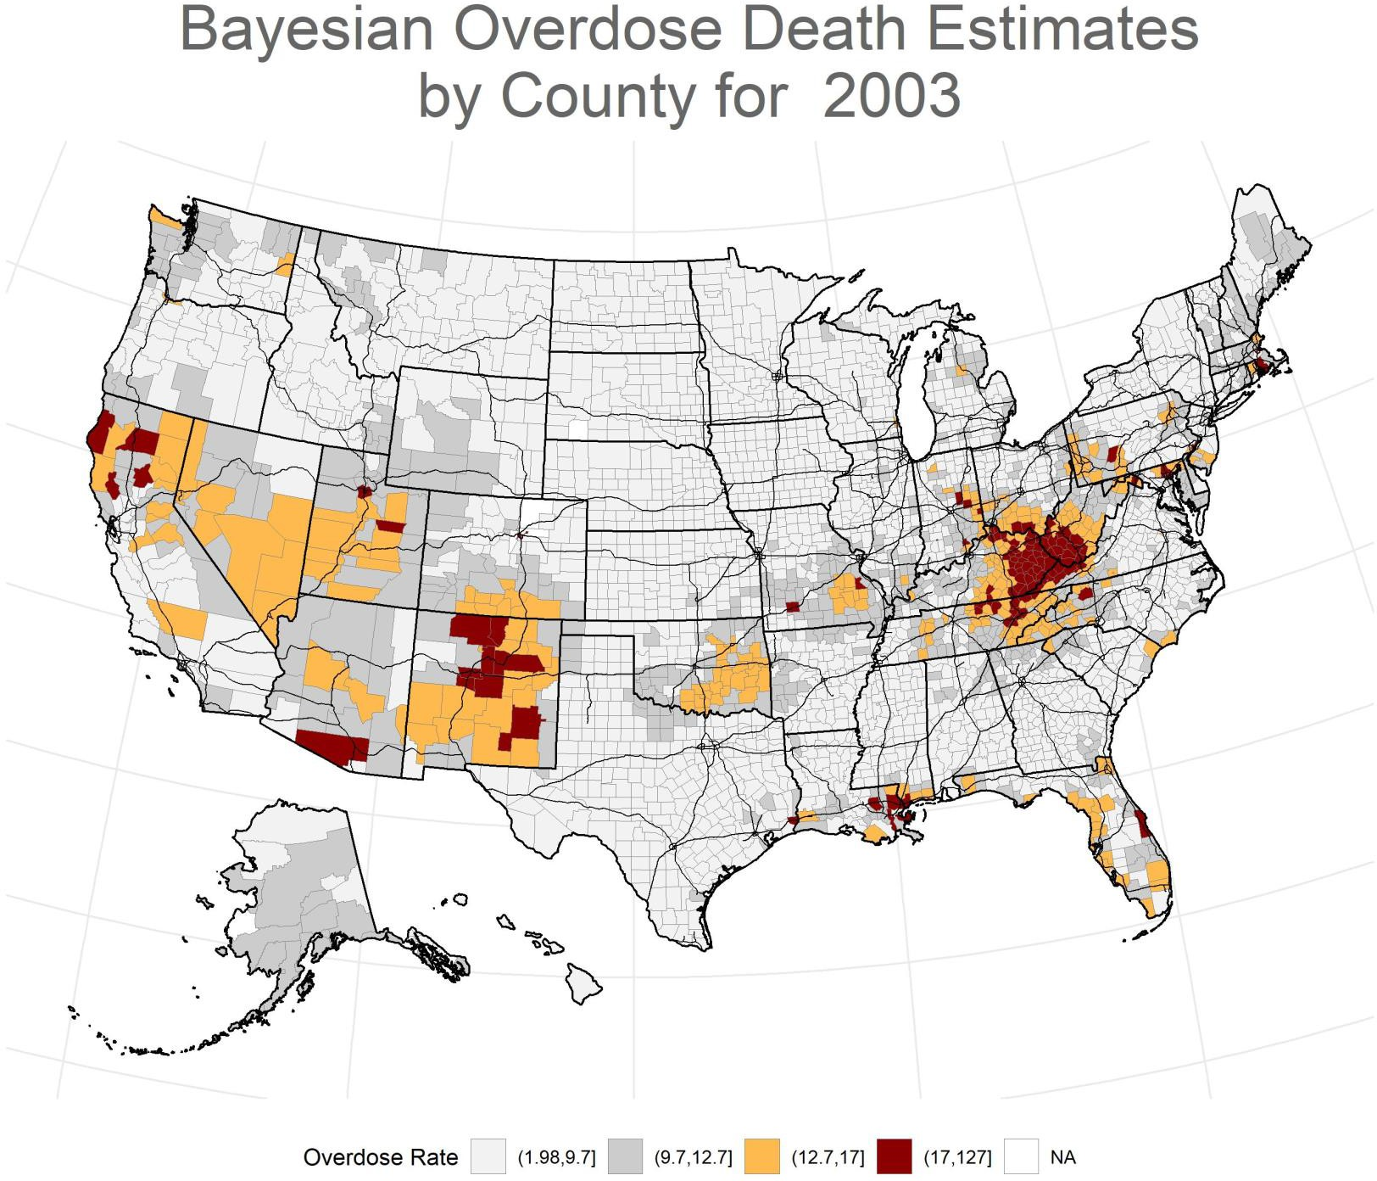

County-level estimates were generated using Hierarchical Bayesian models with spatial and temporal random effects using the INLA package for R (3,10–11). These models borrow strength over time and across neighboring counties to produce stable estimates of drug overdose death rates by county and year. Source: NCHS, National Vital Statistics System, mortality data (see http://www.cdc.gov/nchs/death s.htm).

Slide 17
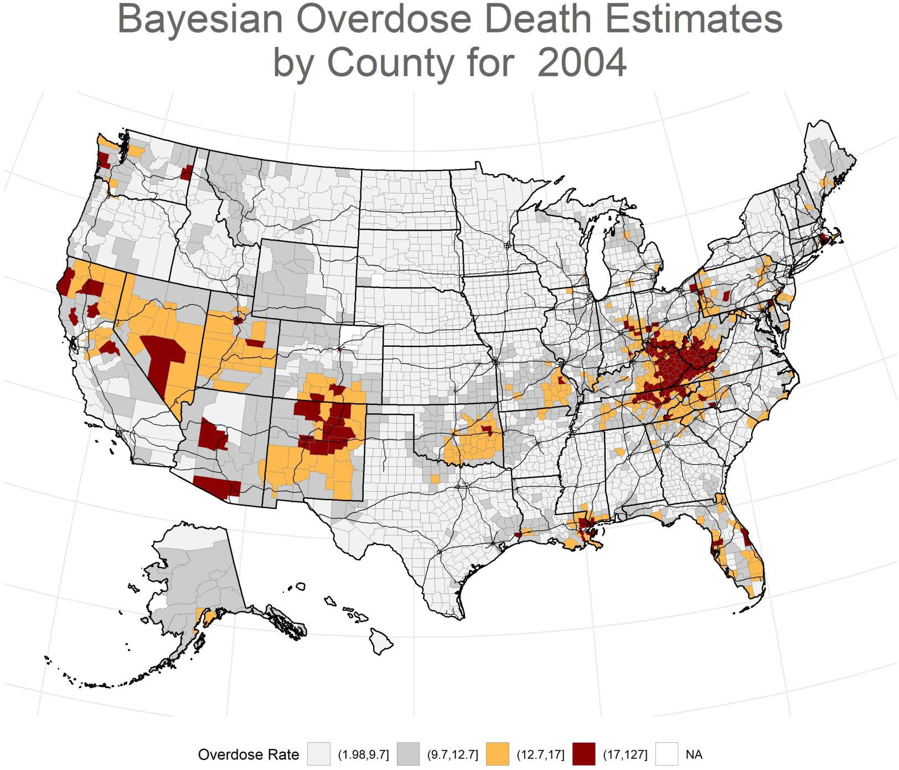
County-level estimates were generated using Hierarchical Bayesian models with spatial and temporal random effects using the INLA package for R (3,10–11). These models borrow strength over time and across neighboring counties to produce stable estimates of drug overdose death rates by county and year. Source: NCHS, National Vital Statistics System, mortality data (see http://www.cdc.gov/nchs/death s.htm).

Slide 18
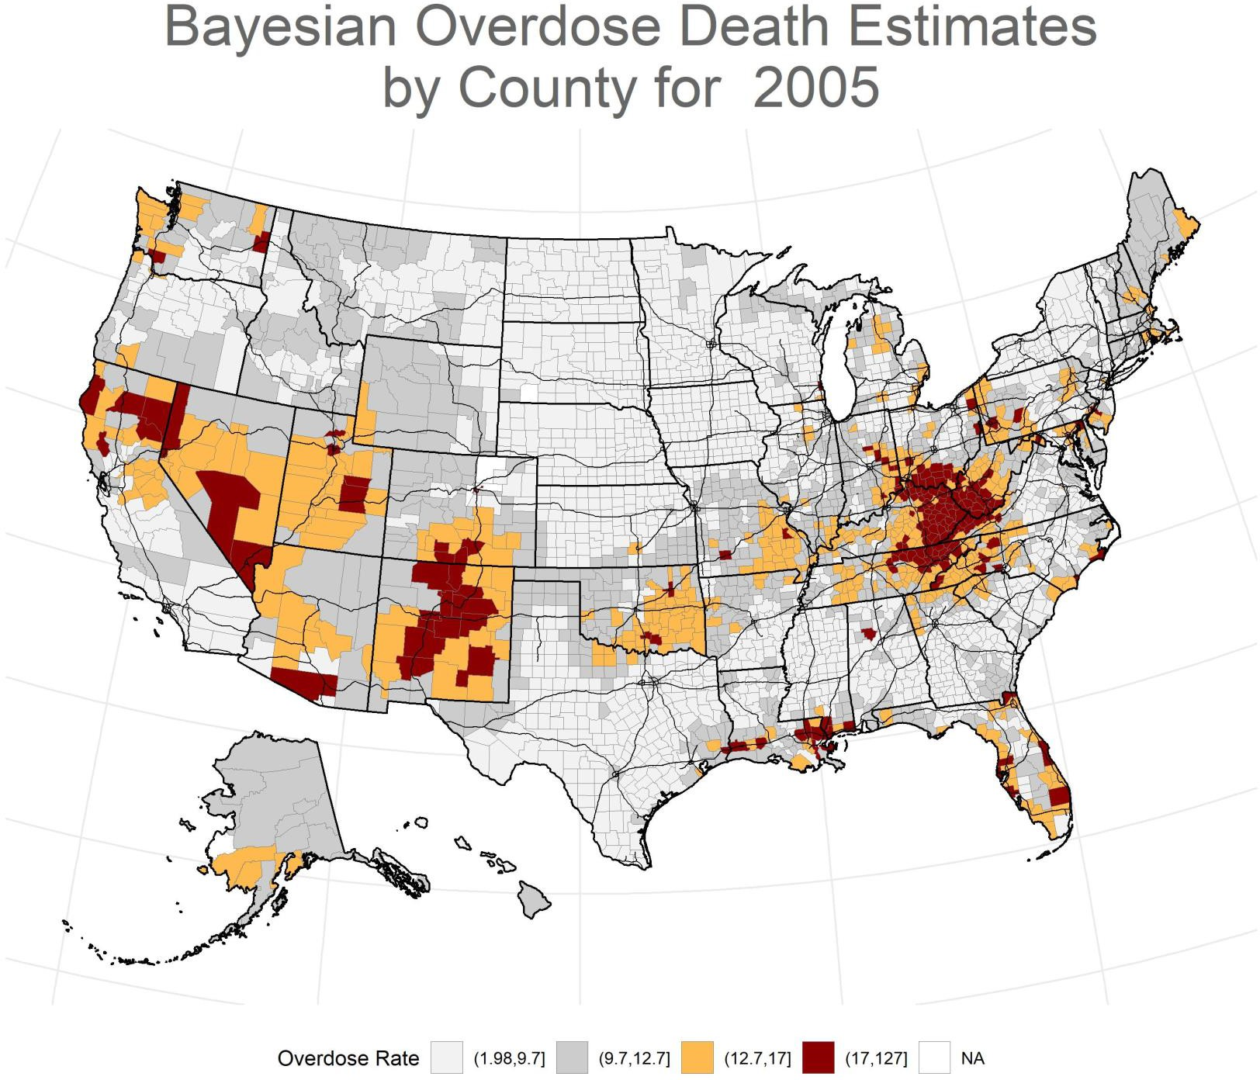
County-level estimates were generated using Hierarchical Bayesian models with spatial and temporal random effects using the INLA package for R (3,10–11). These models borrow strength over time and across neighboring counties to produce stable estimates of drug overdose death rates by county and year. Source: NCHS, National Vital Statistics System, mortality data (see http://www.cdc.gov/nchs/death s.htm).

Slide 19
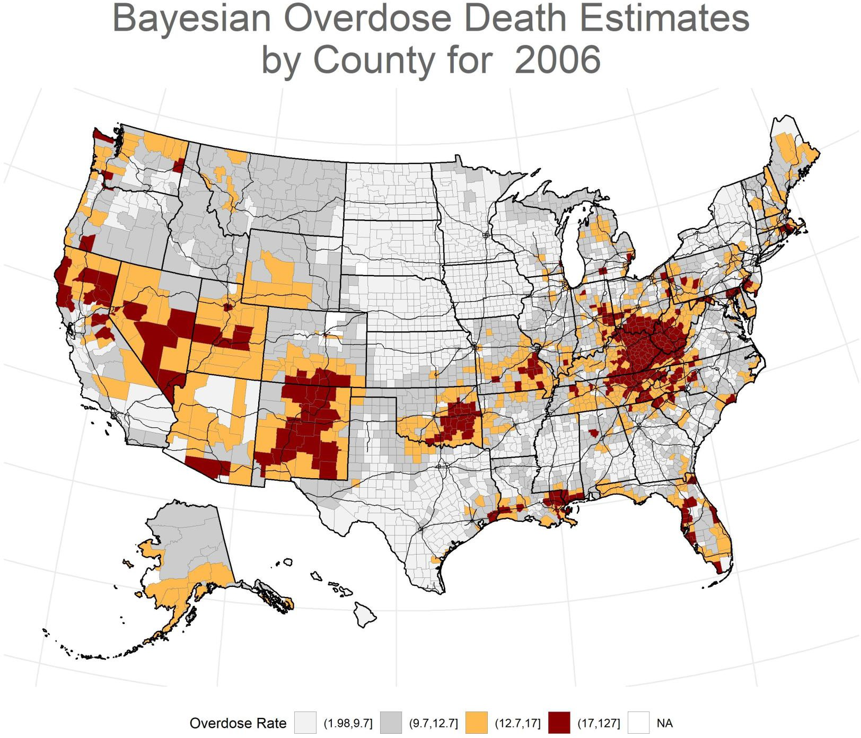
County-level estimates were generated using Hierarchical Bayesian models with spatial and temporal random effects using the INLA package for R (3,10–11). These models borrow strength over time and across neighboring counties to produce stable estimates of drug overdose death rates by county and year. Source: NCHS, National Vital Statistics System, mortality data (see http://www.cdc.gov/nchs/death s.htm).

Slide 20
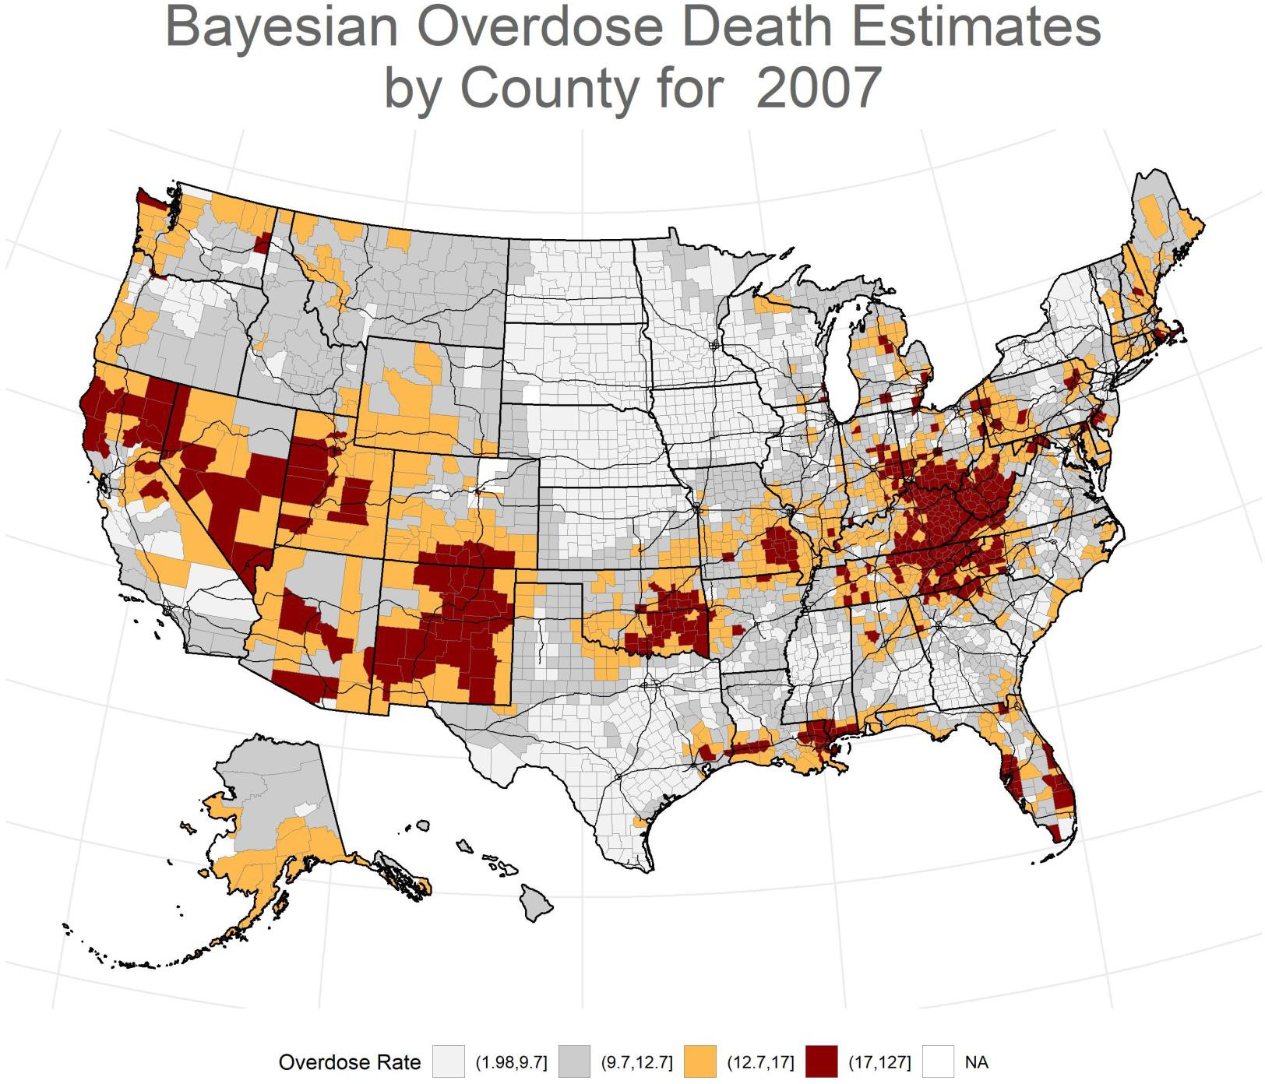
County-level estimates were generated using Hierarchical Bayesian models with spatial and temporal random effects using the INLA package for R (3,10–11). These models borrow strength over time and across neighboring counties to produce stable estimates of drug overdose death rates by county and year. Source: NCHS, National Vital Statistics System, mortality data (see http://www.cdc.gov/nchs/death s.htm).

Slide 21

County-level estimates were generated using Hierarchical Bayesian models with spatial and temporal random effects using the INLA package for R (3,10–11). These models borrow strength over time and across neighboring counties to produce stable estimates of drug overdose death rates by county and year. Source: NCHS, National Vital Statistics System, mortality data (see http://www.cdc.gov/nchs/death s.htm).

Slide 22

County-level estimates were generated using Hierarchical Bayesian models with spatial and temporal random effects using the INLA package for R (3,10–11). These models borrow strength over time and across neighboring counties to produce stable estimates of drug overdose death rates by county and year. Source: NCHS, National Vital Statistics System, mortality data (see http://www.cdc.gov/nchs/death s.htm).

Slide 23

County-level estimates were generated using Hierarchical Bayesian models with spatial and temporal random effects using the INLA package for R (3,10–11). These models borrow strength over time and across neighboring counties to produce stable estimates of drug overdose death rates by county and year. Source: NCHS, National Vital Statistics System, mortality data (see http://www.cdc.gov/nchs/death s.htm).

Slide 24

County-level estimates were generated using Hierarchical Bayesian models with spatial and temporal random effects using the INLA package for R (3,10–11). These models borrow strength over time and across neighboring counties to produce stable estimates of drug overdose death rates by county and year. Source: NCHS, National Vital Statistics System, mortality data (see http://www.cdc.gov/nchs/death s.htm).

Slide 25
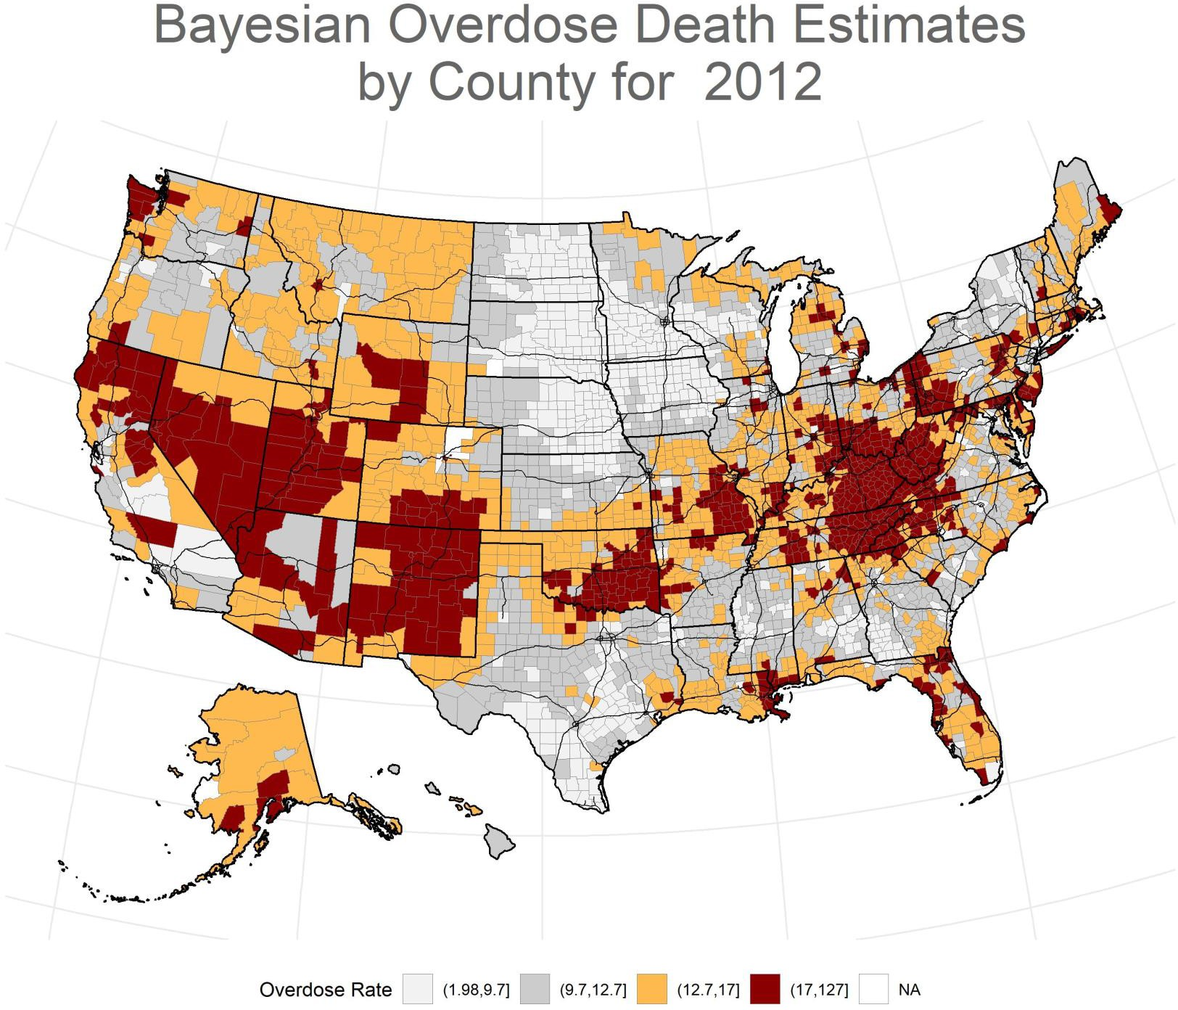
County-level estimates were generated using Hierarchical Bayesian models with spatial and temporal random effects using the INLA package for R (3,10–11). These models borrow strength over time and across neighboring counties to produce stable estimates of drug overdose death rates by county and year. Source: NCHS, National Vital Statistics System, mortality data (see http://www.cdc.gov/nchs/death s.htm).

Slide 26
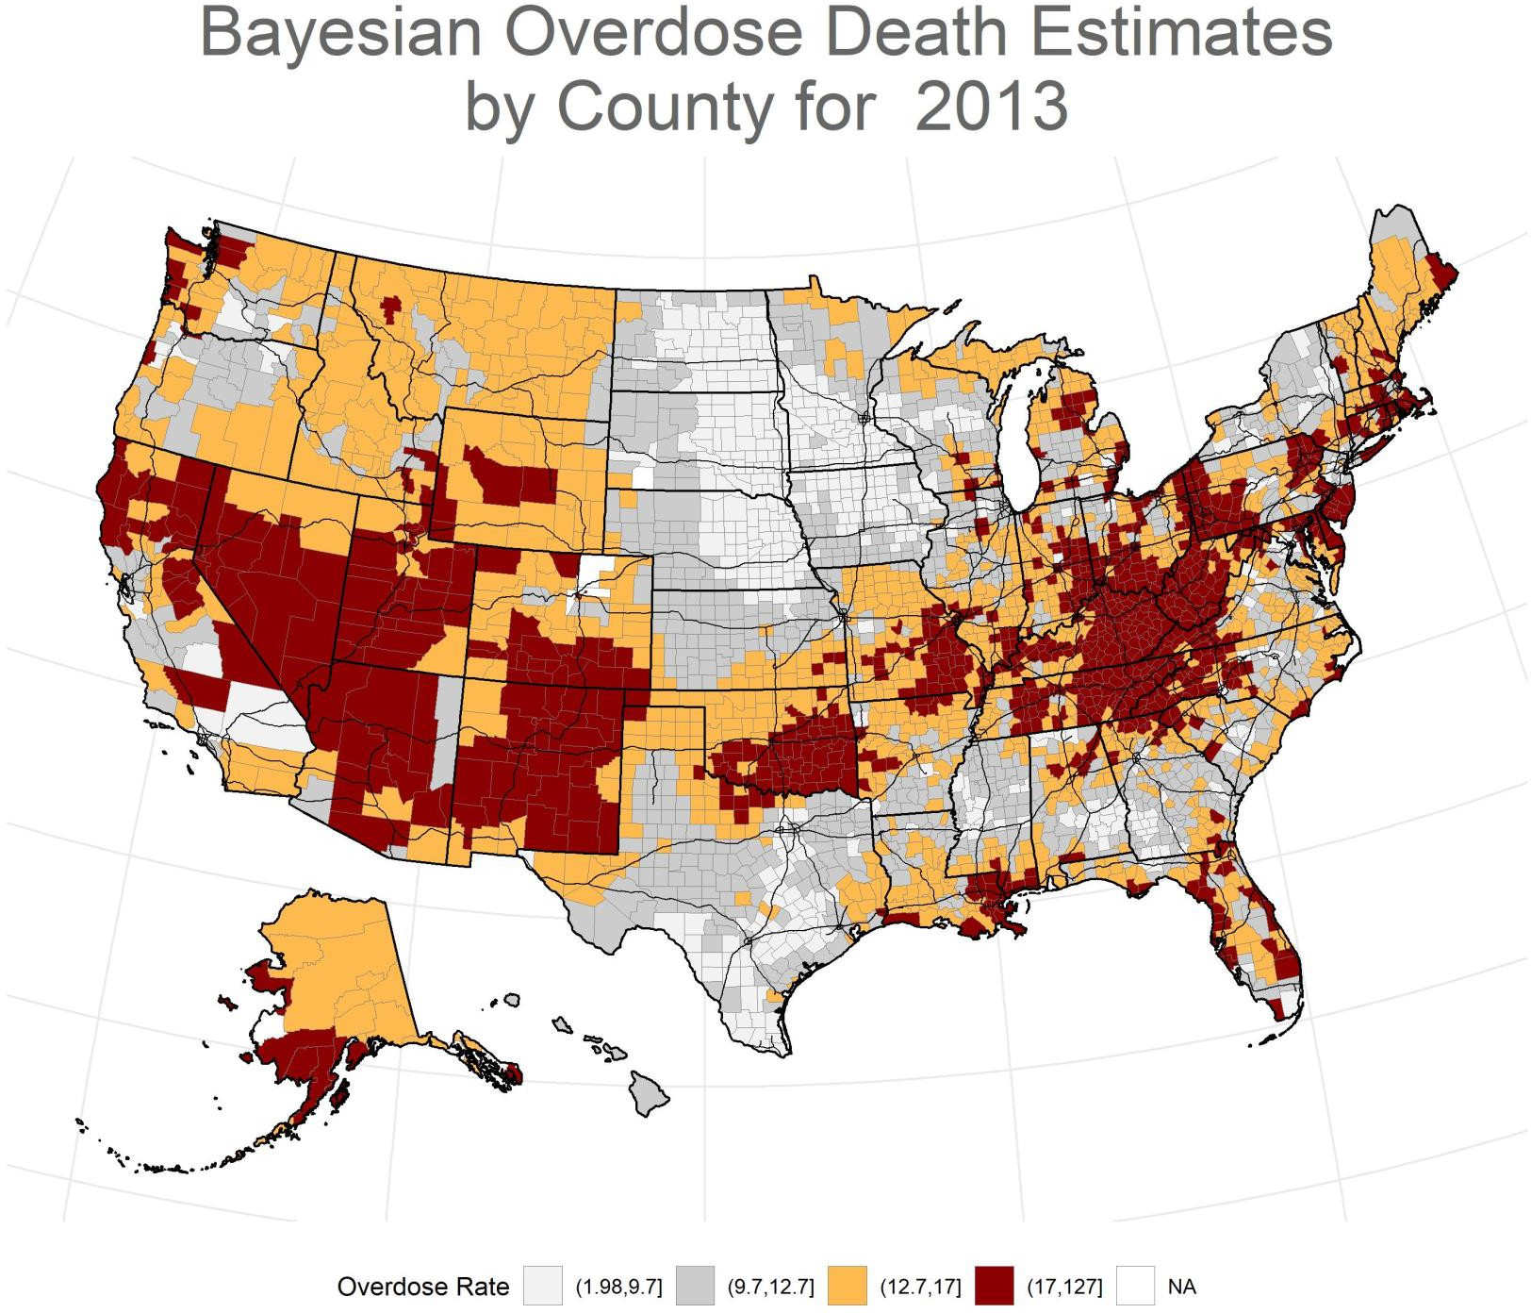
County-level estimates were generated using Hierarchical Bayesian models with spatial and temporal random effects using the INLA package for R (3,10–11). These models borrow strength over time and across neighboring counties to produce stable estimates of drug overdose death rates by county and year. Source: NCHS, National Vital Statistics System, mortality data (see http://www.cdc.gov/nchs/death s.htm).

Slide 27
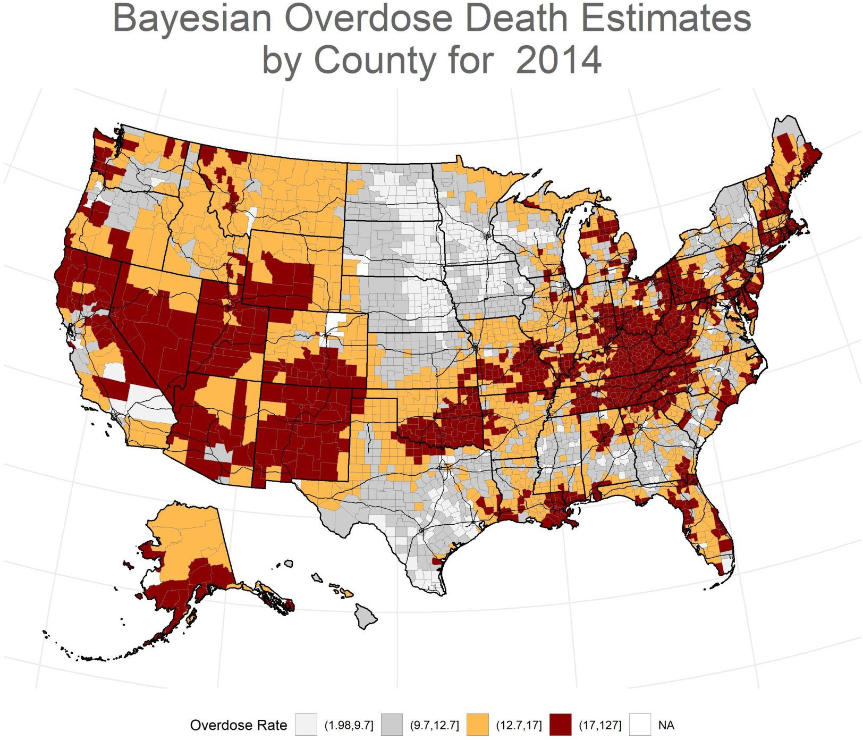
County-level estimates were generated using Hierarchical Bayesian models with spatial and temporal random effects using the INLA package for R (3,10–11). These models borrow strength over time and across neighboring counties to produce stable estimates of drug overdose death rates by county and year. Source: NCHS, National Vital Statistics System, mortality data (see http://www.cdc.gov/nchs/death s.htm).

Slide 28
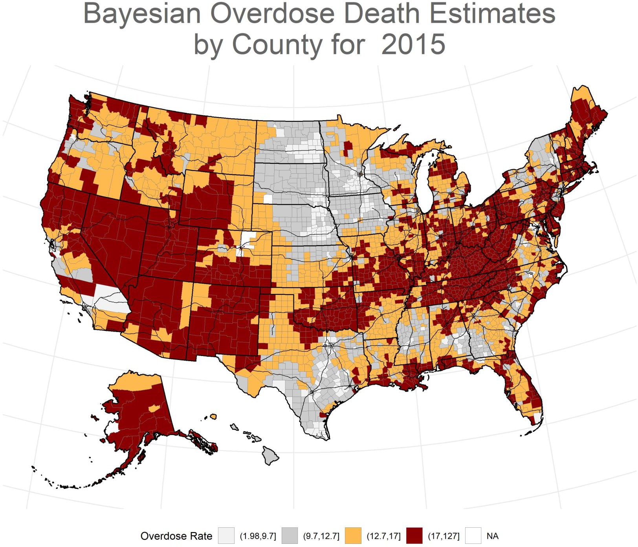
County-level estimates were generated using Hierarchical Bayesian models with spatial and temporal random effects using the INLA package for R (3,10–11). These models borrow strength over time and across neighboring counties to produce stable estimates of drug overdose death rates by county and year. Source: NCHS, National Vital Statistics System, mortality data (see http://www.cdc.gov/nchs/death s.htm).

Slide 29
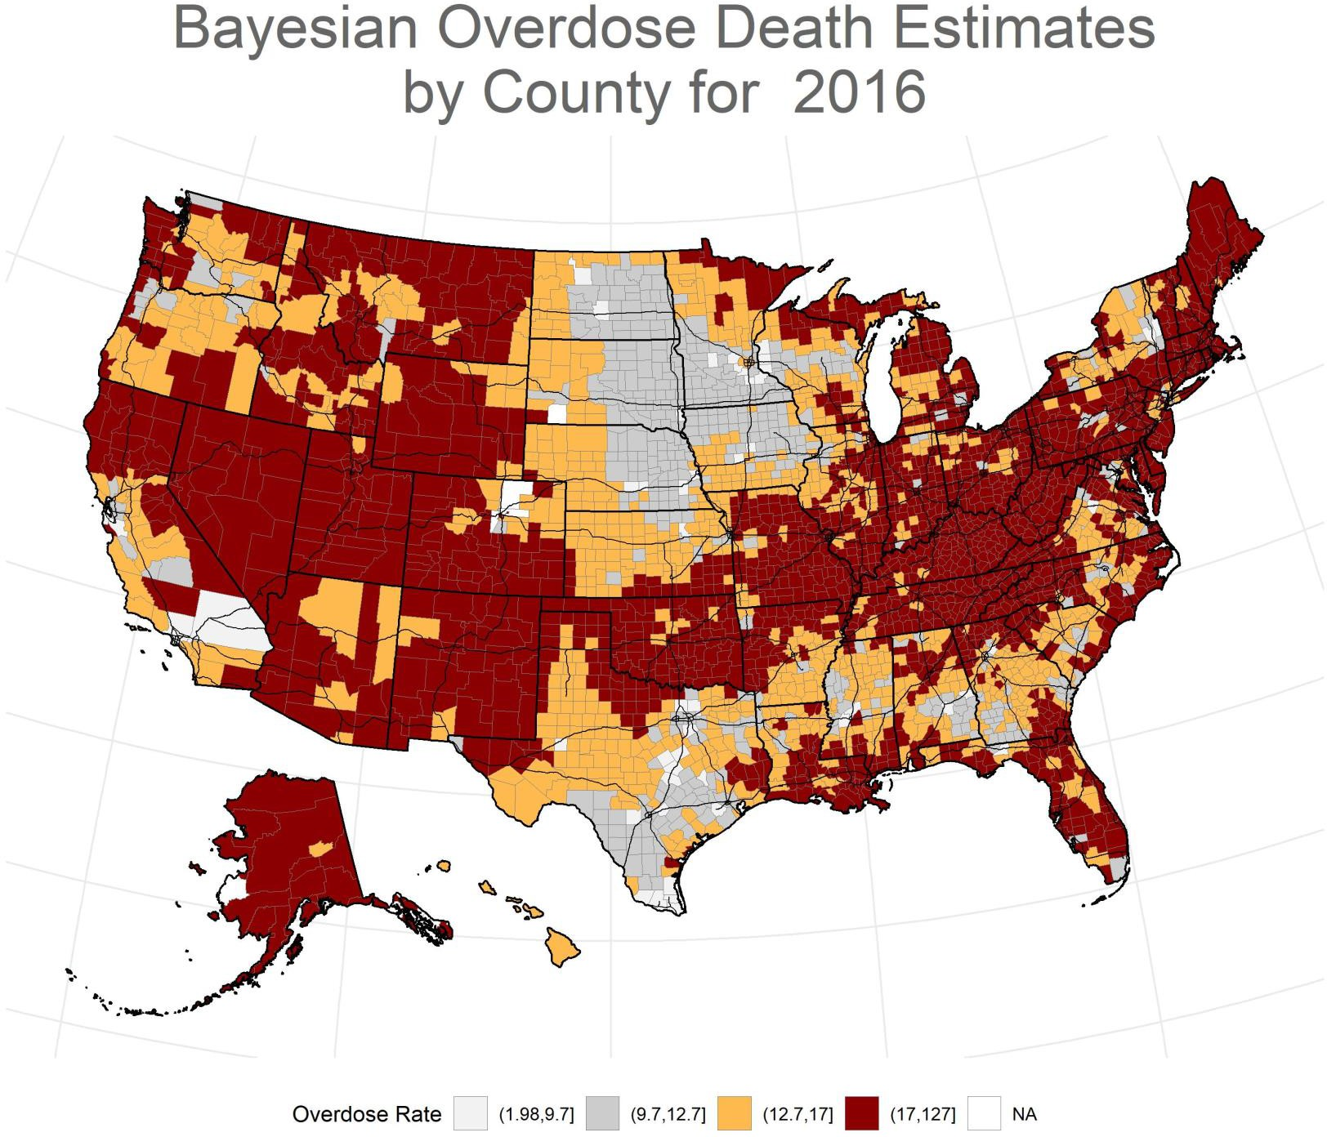
County-level estimates were generated using Hierarchical Bayesian models with spatial and temporal random effects using the INLA package for R (3,10–11). These models borrow strength over time and across neighboring counties to produce stable estimates of drug overdose death rates by county and year. Source: NCHS, National Vital Statistics System, mortality data (see http://www.cdc.gov/nchs/death s.htm).

Slide 30
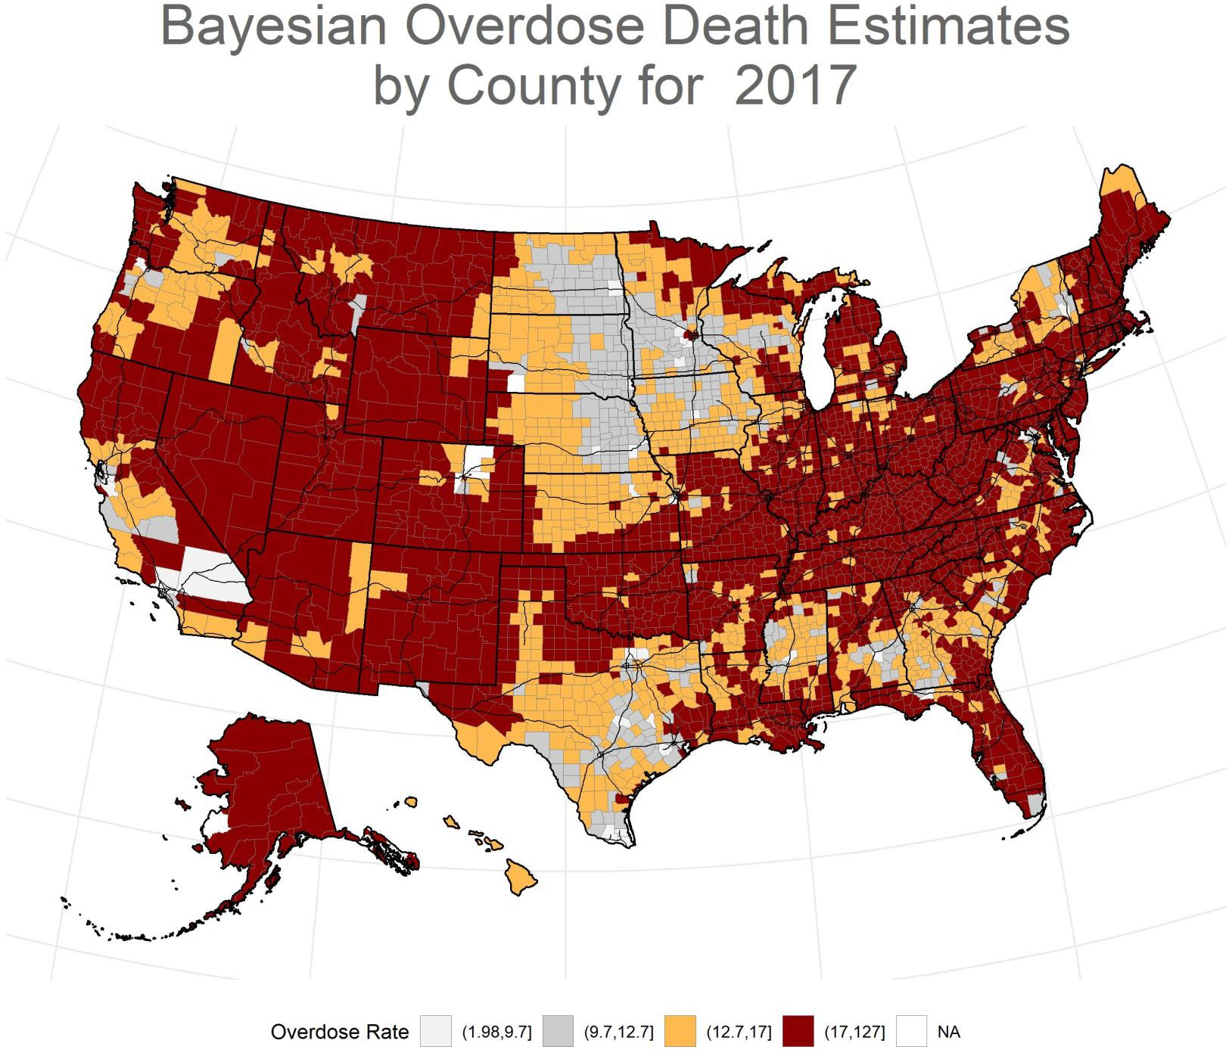
County-level estimates were generated using Hierarchical Bayesian models with spatial and temporal random effects using the INLA package for R (3,10–11). These models borrow strength over time and across neighboring counties to produce stable estimates of drug overdose death rates by county and year. Source: NCHS, National Vital Statistics System, mortality data (see http://www.cdc.gov/nchs/death s.htm).

Slide 31
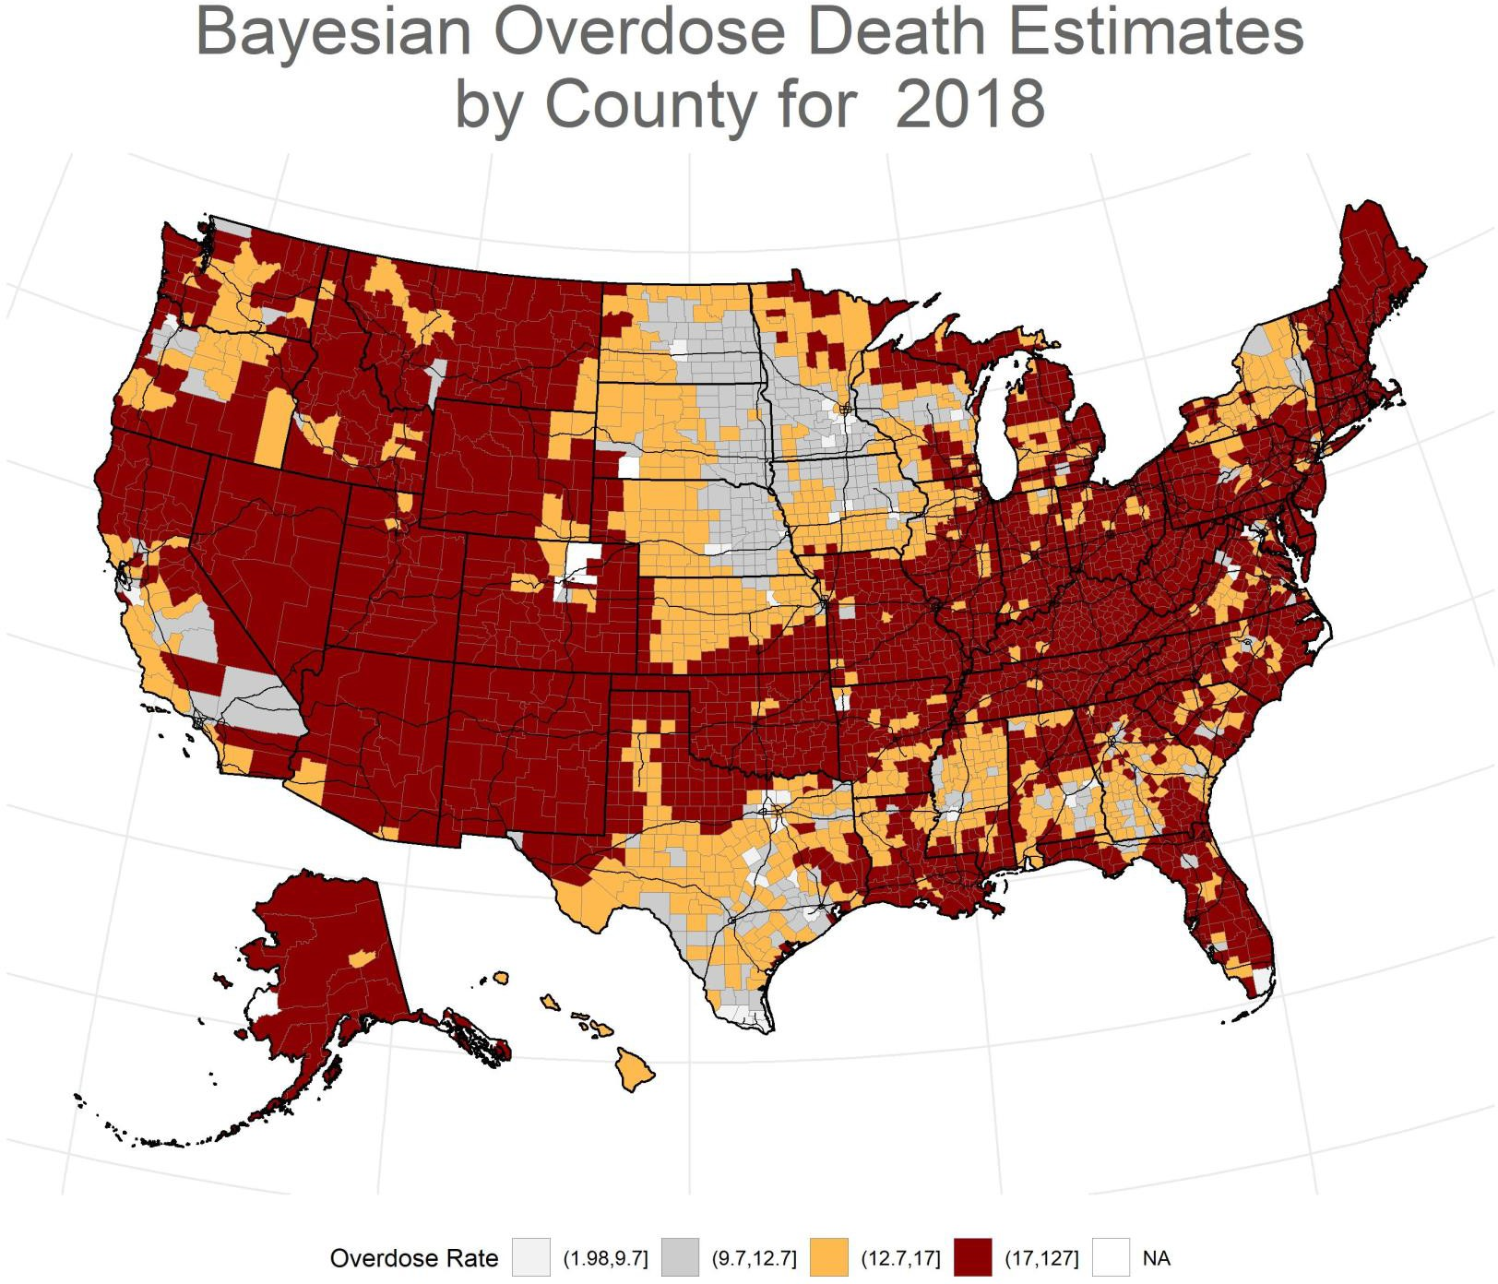
County-level estimates were generated using Hierarchical Bayesian models with spatial and temporal random effects using the INLA package for R (3,10–11). These models borrow strength over time and across neighboring counties to produce stable estimates of drug overdose death rates by county and year. Source: NCHS, National Vital Statistics System, mortality data (see http://www.cdc.gov/nchs/death s.htm).

Slide 32
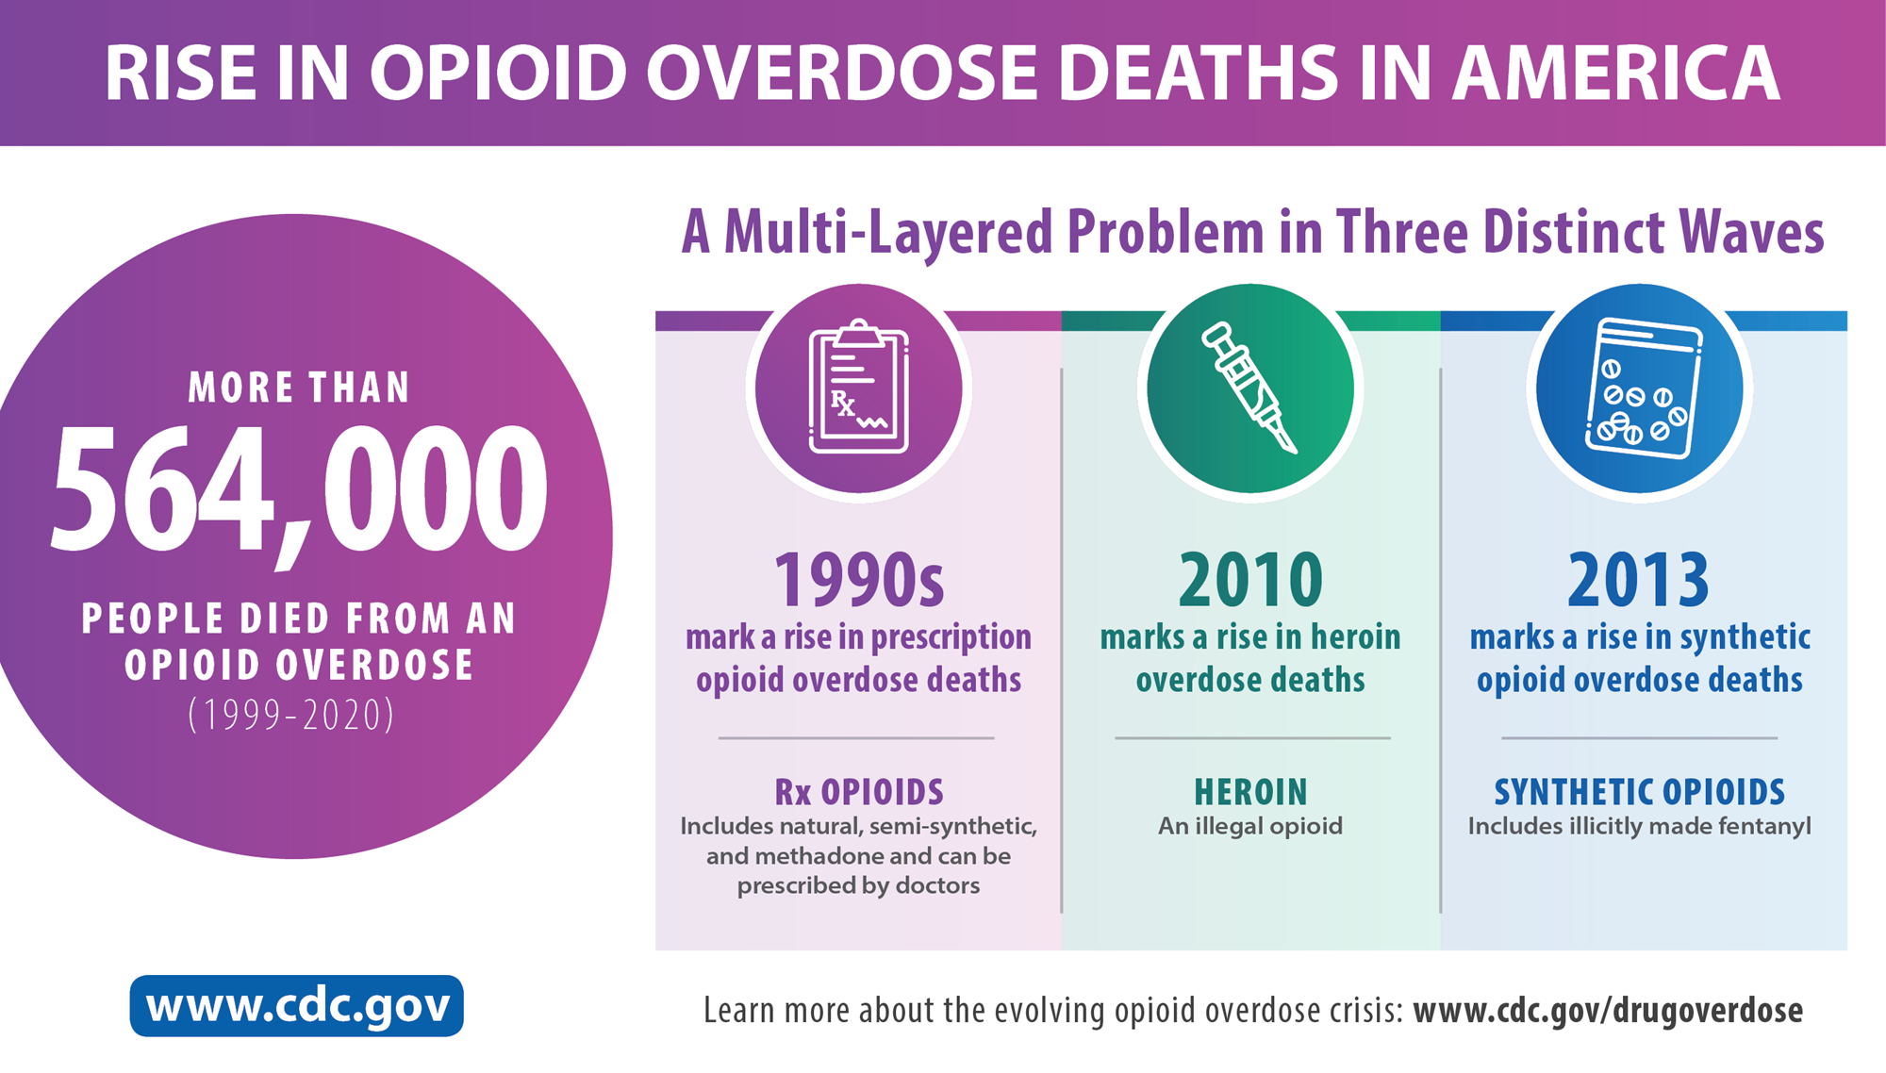

Slide 33
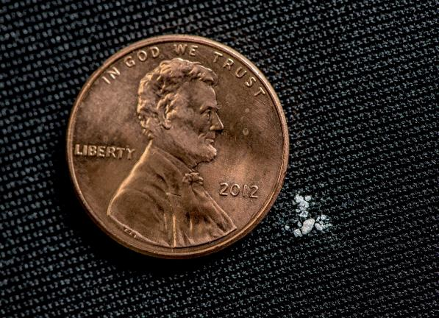
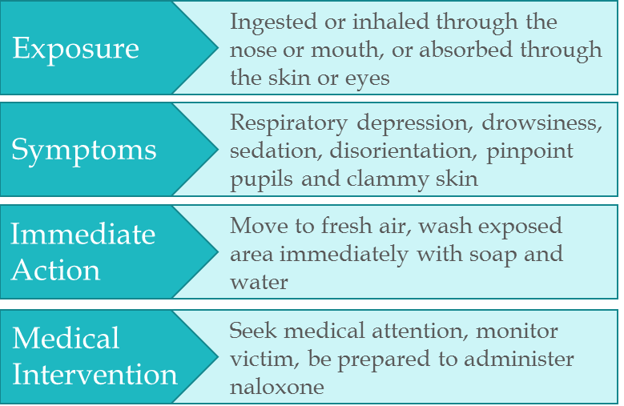
Fentanyl
Notes:
Photo 1: photo illustration of 2 milligrams of fentanyl, a lethal dose in most people
Photo 2: Exposure Risks and Treatment

Slide 34
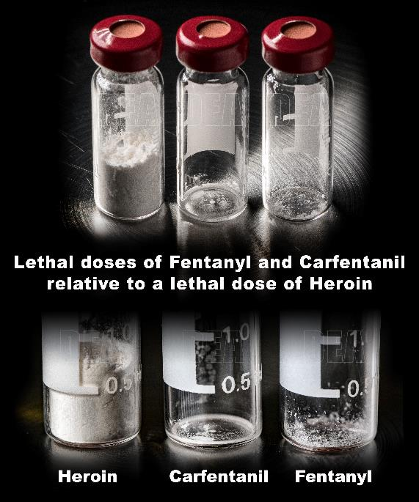
Fentanyl
  Approximately 100 times more potent than morphine and 50 times more potent than heroin as an analgesic
Carfentanil
  Approximately 100 times more potent than Fentanyl
  Veterinary medicine to sedate large animals, primarily elephants
30 milligrams
0.02 milligrams
2 milligrams

Slide 35
Epidemic
194 Drug overdose deaths per day | 68% of those deaths are pharmaceutical opioids or heroin related
Source: Centers for Disease Control and Prevention
Notes:
Self-explanatory
In 2016, there were more than 63,600 drug overdose deaths in the United States
In 2017, CDC Reported value of 70,652 drug overdose deaths in the United States
194 drug overdose per day or one every eight minutes

Slide 36


Thank you
Daniel W. Neill

